Slide 1
Principles of Nutritional Epidemiology
HND-605
Ms. Samia Zainab
Lecturer
Government College University Faisalabad

Slide 2
Nutritional Epidemiology
Epidemiology is the study of determinants, occurrence and distribution of health and disease in a defined population. It studies scientifically the factors that affect the health of individual in the community.
Nutritional Epidemiology is the study of the relationship between diet and health outcomes in population. It aims to understand the impact of diet occurrence and develop evidence based recommendations for public health.
The specific contribution of nutritional epidemiology includes
Dietary assessment
Description of nutritional exposure
Statistical modeling of diet-disease relationship

Slide 3

Examples
In an example from the late 19th century, the unusual occurrence of beri –beri among sailors largely on polished rice to hypothesize that some factor are lacking in their diet; the addition the milk and vegetables to their rations effectively eliminated this disease.
Decades later a deficiency of thiamine was found to be primarily responsible for this syndrome.

Slide 4
Cont…
Nutritional epidemiology plays a crucial role in identify dietary risk factors for chronic diseases and informing public health policies and interventions.
The relationships between the diet and the occurrence of the major disease are both scientific and practical importance to public health nutritionists.
Although epidemiologic efforts originally concentrated primarily on infectious diseases, during the last 30 year attention has largely shifted to the etiology of chronic diseases.
For example hypertension, hypercholesterolemia, and cigarette smoking have been identified as a major determinants of coronary diseases.
This knowledge has contributed to a major decline in this cause of death during recent years.

Slide 5
Critical Concepts in Nutritional Epidemiology
Exposures: Nutritional epidemiology examines the exposure of individuals or population to specific dietary factors, such as macronutrients (carbohydrates, fats, protein), micronutrients (Vitamins, minerals), food groups, or overall dietary patterns.
Outcomes: it investigates various health outcomes, including the incidence of diseases, mortality rates, risk factors, or biomarkers of health (e.g. cholesterol level and blood pressure.
Population based approaches: Nutritional epidemiology focuses on studying large populations to identify patterns and trends, allowing for generalization findings and understanding the broader impact of nutrition on public health.

Slide 6
Principles of Nutritional Epidemiology
Dietary Assessment
Accurate measurement of dietary intake is central to nutritional epidemiology. Several methods are used to collect dietary data, including: 24-hour dietary recalls, food frequency questionnaires (FFQs), dietary records or food diaries, biomarkers.
Validity and Reliability of Dietary Data
It is crucial to ensure that dietary data are both valid (accurately measuring what they are supposed to measure) and reliable (consistent over time or across different situations). Common issues include: recall bias, portion size estimation errors, social desirability bias

Slide 7
Principles of Nutritional Epidemiology
Nutrient and Food Composition Databases
After dietary intake is assessed, it must be translated into nutrient intake. Nutrient composition databases are used for this purpose. These databases provide nutrient content information for foods based on standard measurements, and they must be regularly updated for accuracy.
Study Designs in Nutritional Epidemiology
Various study designs are used to assess the relationship between diet and health outcomes:
Observational studies: Cohort studies, Case-control studies, cross-sectional studies
Experimental studies (Randomized Controlled Trials): Intervention trials

Slide 8
Principles of Nutritional Epidemiology
Exposure and Outcome Assessment
Exposure assessment: This involves measuring dietary intake or specific nutrients and characterizing them in ways that allow for comparison (e.g., total caloric intake, nutrient density).
Outcome assessment: Nutritional epidemiologists typically study outcomes such as disease incidence, mortality, biomarkers, and health conditions (e.g., obesity, diabetes, cardiovascular disease).
Dose-Response Relationship
Nutritional epidemiology looks at whether there is a dose-response relationship between dietary intake and disease risk. For example, it explores whether higher intakes of certain nutrients (e.g., fiber, fruits, or vegetables) are associated with a lower risk of certain diseases, and whether there is a threshold effect.

Slide 9
Principles of Nutritional Epidemiology
Diet-Disease Hypothesis Testing
Based on prior knowledge, epidemiologists often formulate and test hypotheses about diet and health. This involves defining specific dietary exposures (e.g., saturated fat, sugar intake) and testing their associations with diseases or health outcomes.
Interaction of Diet with Genetics and Environment
Nutritional epidemiology also considers gene-diet interactions (nutrigenetics) and how environmental factors (e.g., food availability, pollution) interact with diet to influence health.
Public Health Implications
Nutritional epidemiology plays a key role in forming public health recommendations and guidelines. By identifying dietary patterns and nutrients associated with disease prevention, these studies inform policies aimed at improving population health, such as dietary guidelines, food fortification programs, and public health campaigns.
Challenges in Nutritional Epidemiology
Complexity of diet
Long latency period
Measurement errors

Slide 10
Applications of Nutritional Epidemiology
Nutritional epidemiology provides evidence to inform the development of evidence based dietary guidelines by identifying association between specific nutrients, food groups, dietary patterns and disease risk.
It guides the development of strategies to promote healthy eating habits and prevents nutrition related diseases in populations.
Nutritional epidemiology influences policy decisions related to food labeling, marketing regulations, school nutrition programs or taxation on certain food items.

Slide 11
Objectives of Nutritional Epidemiology research
Identify dietary risk factors for disease
Understand the role of nutrition in diseases prevention
Assess Nutritional status and its impact on health
Examine the Impact of Diet on Mortality and Morbidity
Develop and Evaluate Dietary Guidelines
Investigate the Role of Nutrition in Public Health
Examine Nutritional Disparities
Explore Gene-Diet Interactions
Monitor Trends in Dietary Intake and Health
Develop Methods for Dietary Assessment

Slide 12
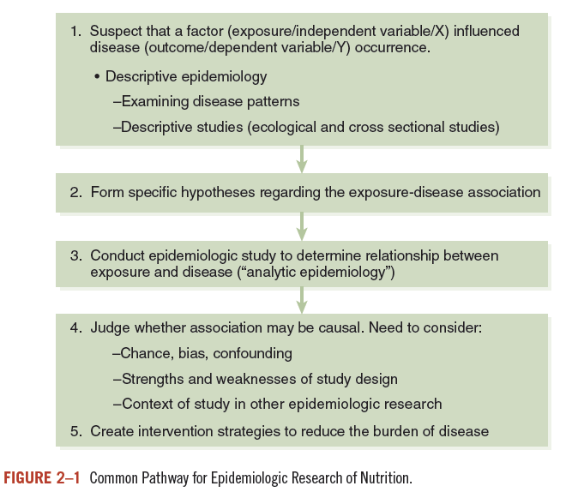

Slide 13
Interpretation
Interpretation of nutritional epidemiology involves understanding and applying findings from research that examines the relationships between diet, nutritional factors, and health outcomes. The field aims to identify dietary factors that influence the risk of disease, inform public health guidelines, and promote better nutrition to improve health across populations.
Key Aspects
Assessing Causal Relationships
Controlling for Confounding Variables
Dealing with Measurement Errors
Long-Term Effects
Generalizability of Findings
Strength of Evidence
Public Health Implications
Challenges in Interpretation
Dietary Complexity
Recall Bias
Variation in Nutrient Needs

Slide 14
Systematic review
A systematic review is a structured, comprehensive review of all relevant studies on a specific topic or research question. It follows a rigorous and predefined protocol to ensure that the review is objective, transparent, and reproducible.
Formulating a Research Question
Defining Inclusion and Exclusion Criteria
Comprehensive Literature Search
Study Selection
Data Extraction
Critical Appraisal of Study Quality
Synthesis of Results
Role of Systematic Reviews
Summarizing Evidence
Identifying Research Gaps
Guiding Policy and Practice
Reducing Bias

Slide 15
Role of Meta Analysis
A meta-analysis is a statistical technique used within a systematic review to combine the results of multiple studies on the same topic. It provides a quantitative summary of the evidence, often in the form of a pooled effect size.
Increasing Statistical Power
Clarifying Inconsistent Findings
Guiding Clinical Practice and Policy
Advantages of Systematic Reviews and Meta-Analyses
Comprehensive Evidence
Reduced Bias
Increased Precision
Evidence-Based Practice

